Slide 1
Lecture 3

Slide 2
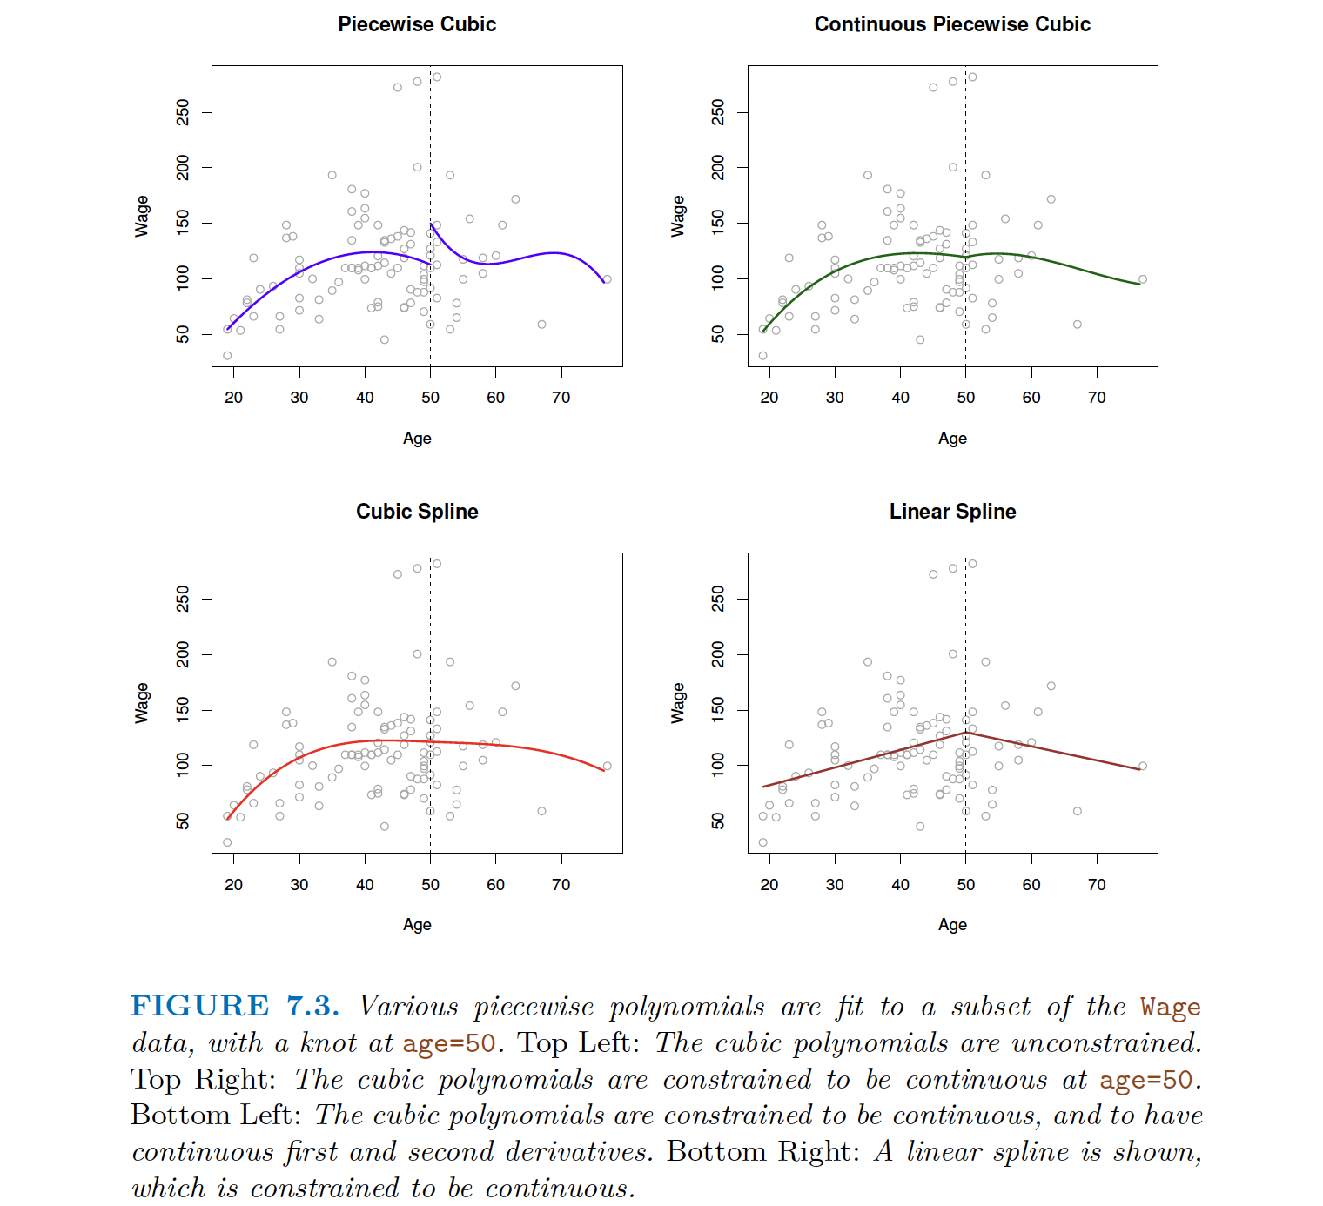

Slide 3
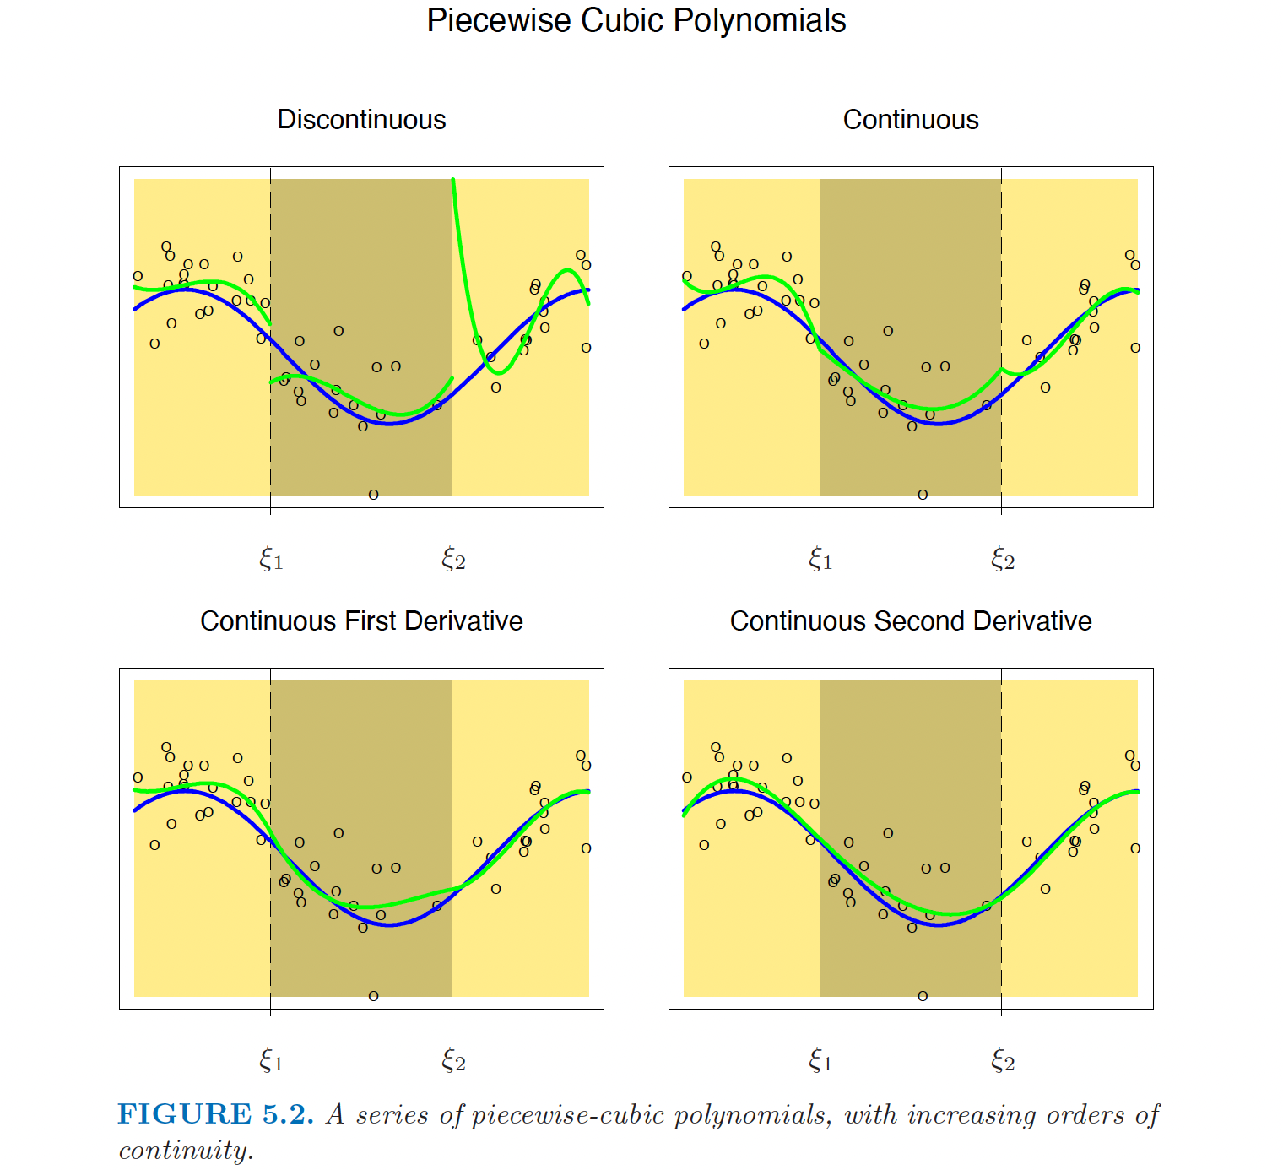

Slide 4
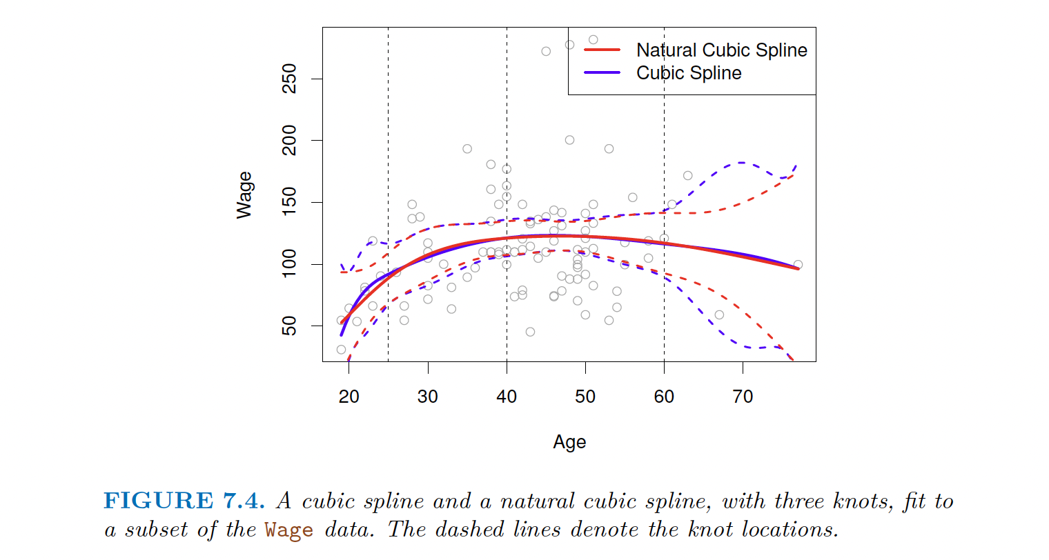

Slide 5
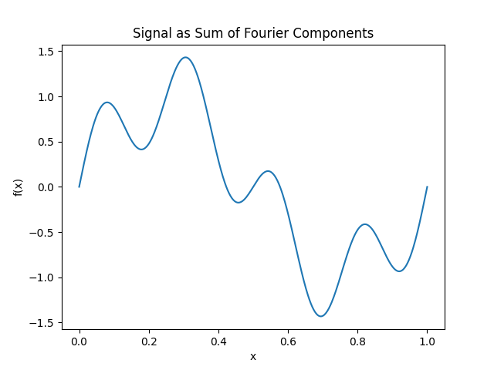
Fourier Representation
A signal expressed as a combination of low- and high-frequency Fourier components.

Slide 6
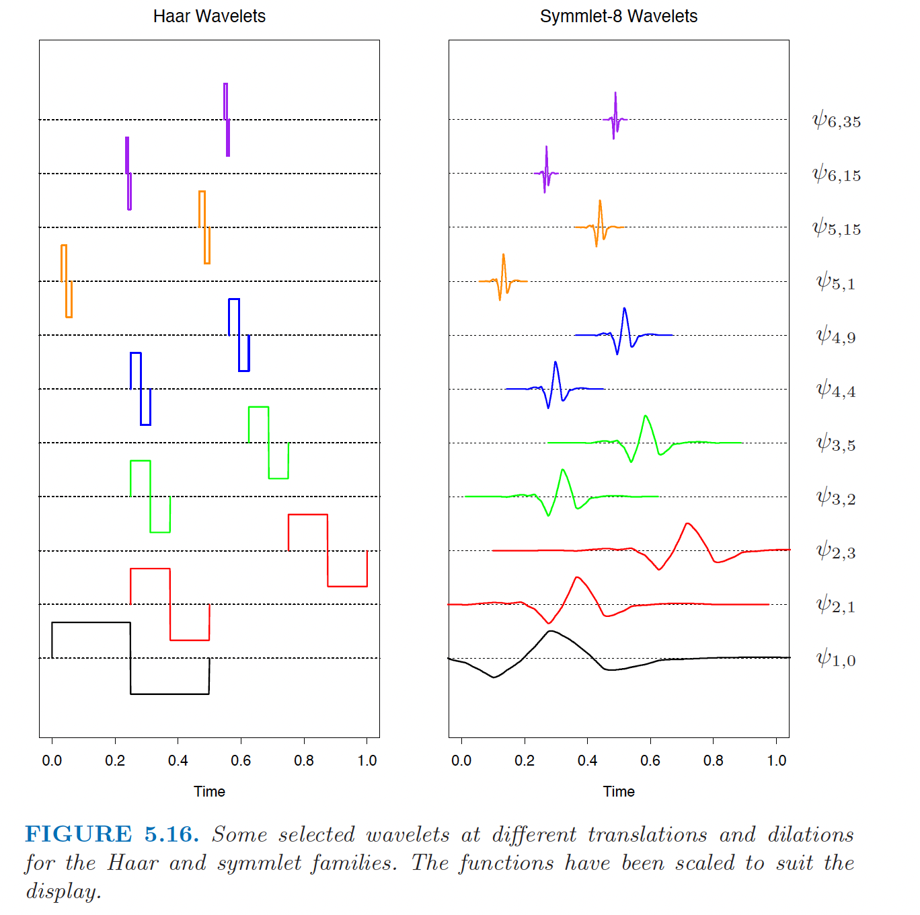
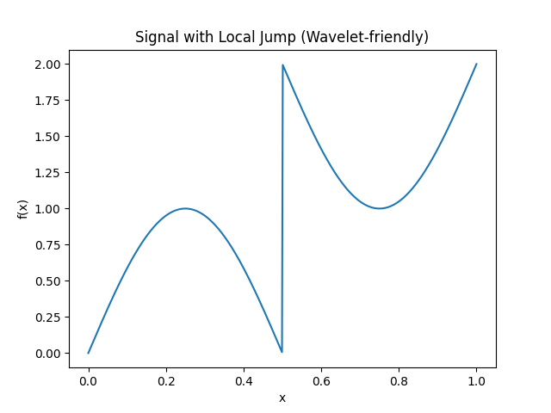
Wavelets Expansion
A signal with a local jump: difficult for Fourier, well-captured by wavelets.

Slide 7
